Slide 1

SDET Course
Design Patterns - Abstract Factory

Slide 2
3 Types of Design Patterns
Creational
Singleton
Builder
Prototype
Factory Method
Abstract Factory
Structural
Adapter
Composite
Proxy
Flyweight
Bridge
Facade
Decorator
Behavioral
Strategy
Observer
Command
Memento
State
Template Method
Mediator
Chain of Responsibility
Interpreter
Visitor
Iterator

Slide 3
Agenda
Description
Diagram
Code sample (Java)
Use cases

Slide 4

The Problem
Introduction - The amusement park continues

Slide 5
Description
The Abstract Factory Design Pattern provides an interface for creating families of related or dependent objects without specifying their concrete classes. This pattern is useful when there is a need to ensure that the created objects can work together and you want to hide the implementation details from the client.

Slide 6
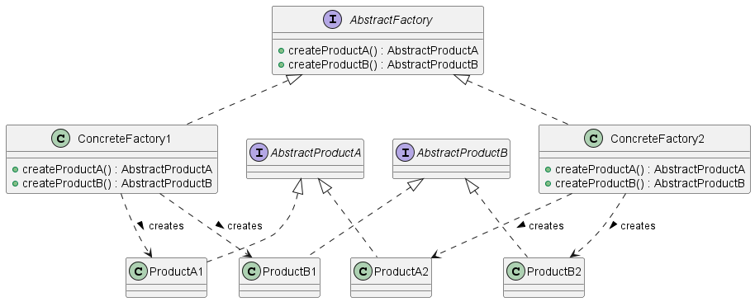
Class Diagram

Slide 7
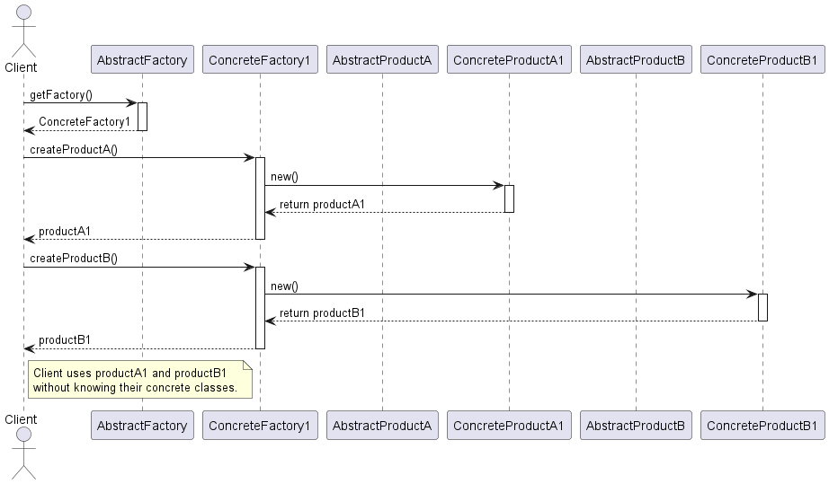
Sequence Diagram

Slide 8
Code Sample

Slide 9
Use cases
General
Vehicle Manufacturing
Database Abstraction Layer
Cross-Platform File System Operations
Theme for applications
In Test Automation
Cross-Platform UI Testing
Browser Compatibility Testing
Mobile App Testing on Different Devices
Similar page objects with small differences (e.g different types of calendar object)

Slide 10
Happy Coding

